Slide 1
Characteristics of OOD
Objects are abstractions of real-world or system entities and manage themselves
Objects are independent and encapsulate state and representation information.
System functionality is expressed in terms of object services
Shared data areas are eliminated
Objects communicate by message passing
Objects may be distributed
Objects may execute sequentially or in parallel

Slide 2
Interacting objects

Slide 3
Advantages of OOD
Easier maintenance. Objects may be understood as stand-alone entities
Objects are appropriate reusable components
For some systems, there may be an obvious mapping from real world entities to system objects

Slide 4
Objects and object classes
Objects are entities in a software system which represent instances of real-world and system entities
Object classes are templates for objects
Classes may be used to create objects
Object classes may inherit attributes and services from other object classes

Slide 5
Object communication
Conceptually, objects communicate by message passing
Messages
The name of the service requested by the calling object.
Copies of the information required to execute the service and the name of a holder for the result of the service.
In practice, messages are often implemented by procedure calls
Name = method name
Information = parameter list
Result holder = method return value

Slide 6
Generalisation and inheritance
Objects are members of classes which define attribute types and operations
Classes may be arranged in a class hierarchy where one class (a super-class) is a generalisation of one or more other classes (sub-classes)
A sub-class inherits the attributes and operations from its super class and may add new methods or attributes of its own
It is a reuse mechanism at both the design and the programming level
Inheritance introduces complexity and this is undesirable, especially in critical systems

Slide 7
A generalisation hierarchy

Slide 8
Object Relationships
Objects and object classes participate in relationships with other objects and object classes
In UML, such a relationship is indicated by an association
Associations may be annotated with information that describes the association

Slide 9
Concurrent objects
The nature of objects as self-contained entities make them suitable for concurrent implementation
The message-passing model of object communication can be implemented directly if objects are running on separate processors in a distributed system
Active objects have an internal thread of control and may change their own state

Slide 10
Object identification
Identifying objects (or object classes) is the most difficult part of object oriented design
There is no “magic formula” for object identification
It relies on the skill, experience and domain knowledge of system designers
Object identification is an iterative process
You are unlikely to get it right first time

Slide 11
Approaches to identification
Use a grammatical approach based on a natural language description of the system (used in Hood method)
Base the identification on tangible things in the application domain
Use a behavioural approach and identify objects based on what participates in what behaviour
Use a scenario-based analysis – the objects, attributes and methods in each scenario are identified

Slide 12
Object interface specification
Object interfaces have to be specified so that the objects and other components can be designed in parallel
Designers should avoid designing the interface representation but should hide this in the object itself
Objects may have several interfaces which are viewpoints on the methods provided

Slide 13
Design models
Design models show the objects and object classes and relationships between these entities
Static models describe the static structure of the system in terms of object classes and relationships
Dynamic models describe the dynamic interactions between objects.

Slide 14
UML diagrams: use cases
A use case encodes a typical user interaction with the system. In particular, it:
captures some user-visible function.
achieves some concrete goal for the user.
A complete set of use cases largely defines the requirements for your system: everything the user can see, and would like to do.
The granularity of your use cases determines the number of them (for you system). A clear design depends on showing the right level of detail.
A use case maps actors to functions. The actors need not be people.

Slide 15

Use case examples, 1 (High-level use case for powerpoint.)

Slide 16
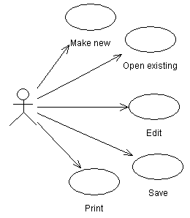
Use case examples, 2 (Finer-grained use cases for powerpoint.)

Slide 17
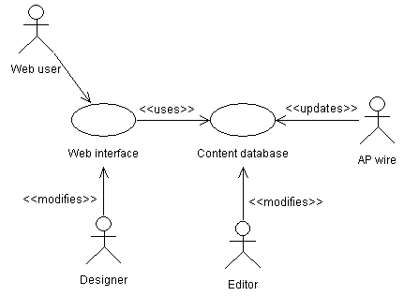
Use case examples, 3 (Relationships in a news web site.)

Slide 18
About the last example...
The last is more complicated and realistic use case diagram. It captures several key use cases for the system.
Note the multiple actors. In particular, ‘AP wire’ is an actor, with an important interaction with the system, but is not a person (or even a computer system, necessarily).
The notes between << >> marks are stereotypes: identifiers added to make the diagram more informative. Here they differentiate between different roles (ie, different meanings of an arrow in this diagram).

Slide 19
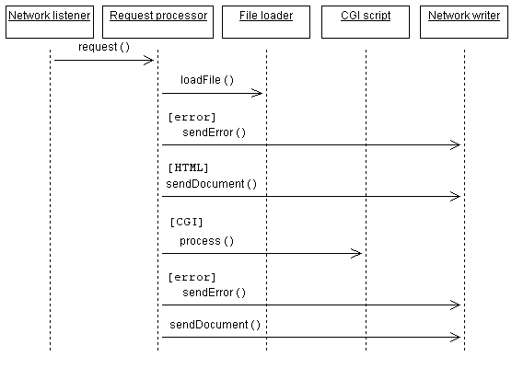
Sequence diagram example

Slide 20
Sequence Diagrams
A Sequence diagram is an interaction diagram that shows how processes operate with one another and in what order.
A sequence diagram shows object interactions arranged in time sequence.
Sequence diagrams are sometimes called event diagrams or event scenarios.

Slide 21
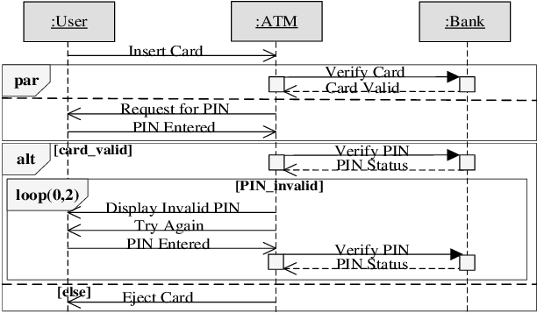
Sequence Diagram for ATM

Slide 22
How to make Sequence Diagrams
Pick a scenario that you want to model
Try to identify the objects that will be involved in the scenario
Line them across the top in the approximate order that they're (listed in the order that they are used for the scenario)
Draw dotted lines down indicating lifelines
Identify the first event (triggering event)
Draw a horizontal arrow from the object that sends a message to the object that receives it
identify the next event and the objects involved
Redo steps 6 and 7 until the diagram is complete

Slide 23
Benefits of sequence diagrams
UML sequence diagrams help you to envision what will happen during the execution of a use case
They are great to help developers and business analysts get to a common understanding

Slide 24
UML state diagrams
state diagram: Depicts data and behavior of a single object throughout its lifetime.
set of states (including an initial start state)
transitions between states
entire diagram is drawn from that object's perspective
similar to finite state machines (DFA, NFA, PDA, etc.)
What objects are best used with state diagrams?
large, complex objects with a long lifespan
domain ("model") objects
not useful to do state diagrams for every class in the system!

Slide 25
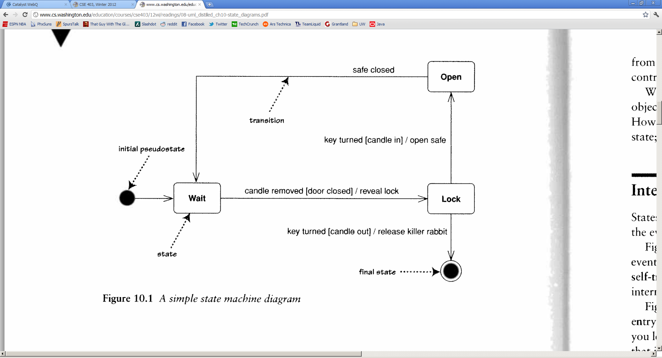
State diagram example

Slide 26
States
state: conceptual description of the data in the object
represented by object's field values
entire diagram is drawn from the central object's perspective
only include states / concepts that this object can see and influence
don't include every possible value for the fields; only ones that are conceptually different

Slide 27
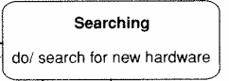
Transitions
transition: movement from one state to another
signature [guard] / activity
signature: event that triggers (potential) state change
guard: boolean condition that must be true
activity: any behavior executed during transition (optional)
transitions must be mutually exclusive (deterministic)
must be clear what transition to take for an event
most transitions are instantaneous, except "do" activities

Slide 28
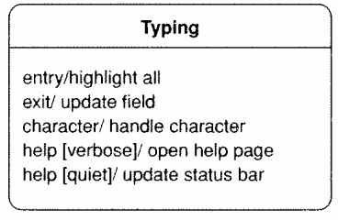
Internal activities
internal activity: actions that the central object takes on itself
sometimes drawn as self-transitions (events that stay in same state)
entry/exit activities
reasons to start/stop being in that state

Slide 29
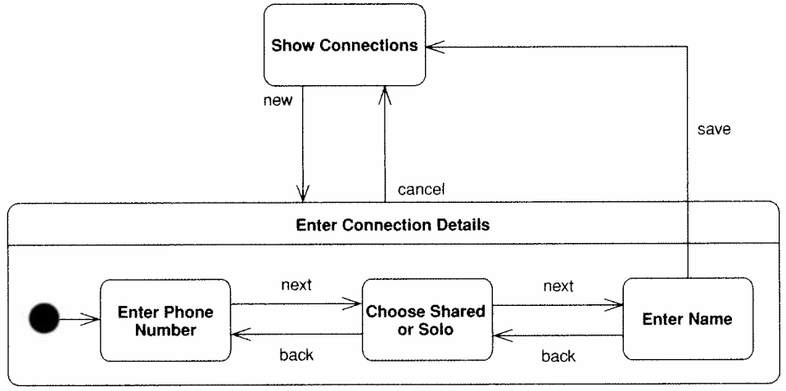
Super/substates
When one state is complex, you can include substates in it.
drawn as nested rounded rectangles within the larger state
Caution: Don't over-use this feature.
easy to confuse separate states for sub-states within one state

Slide 30
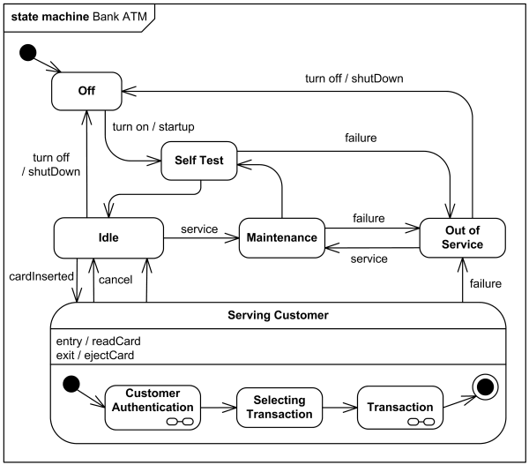
State diagram example
ATM software states at a bank

Slide 31
State pattern
state pattern: An object whose sole purpose is to represent the current "state" or configuration of another larger object.
A behavioral pattern.
Often implemented with an enum type for the states.
Each object represents one specific state for the larger object.
The larger object sets its state in response to various mutations.
Allows various observers and interested parties to quickly and accurately know what is going on with the larger object's status.
Analogous to the notion of finite state machines.
Set of states (nodes)
Set of edges (mutations that cause state changes)
Notes:
difference from Command pattern:
command objects each solve different problems
strategy objects all solve the same problem in different ways

